Slide 1

IDEA SUBMISSION
Problem Statement : Reimagining Waste Management With A Multifaceted Approach using IoT Techniques, Predictive Learning and Distributed Computing
Team Name: 200 OK
Team Leader Name: H G VASUDEVA
Contact mail id: 1ms22ai016@msrit.edu
Description of problem statement:
Designing a robust waste management system to achieve unprecedented efficiency in waste handling, resource recovery, and environmental protection. The novel prototype design utilizes a combination of real-time litter surveillance, intelligent bin technology, and a robust data architecture for a comprehensive approach.

Slide 2
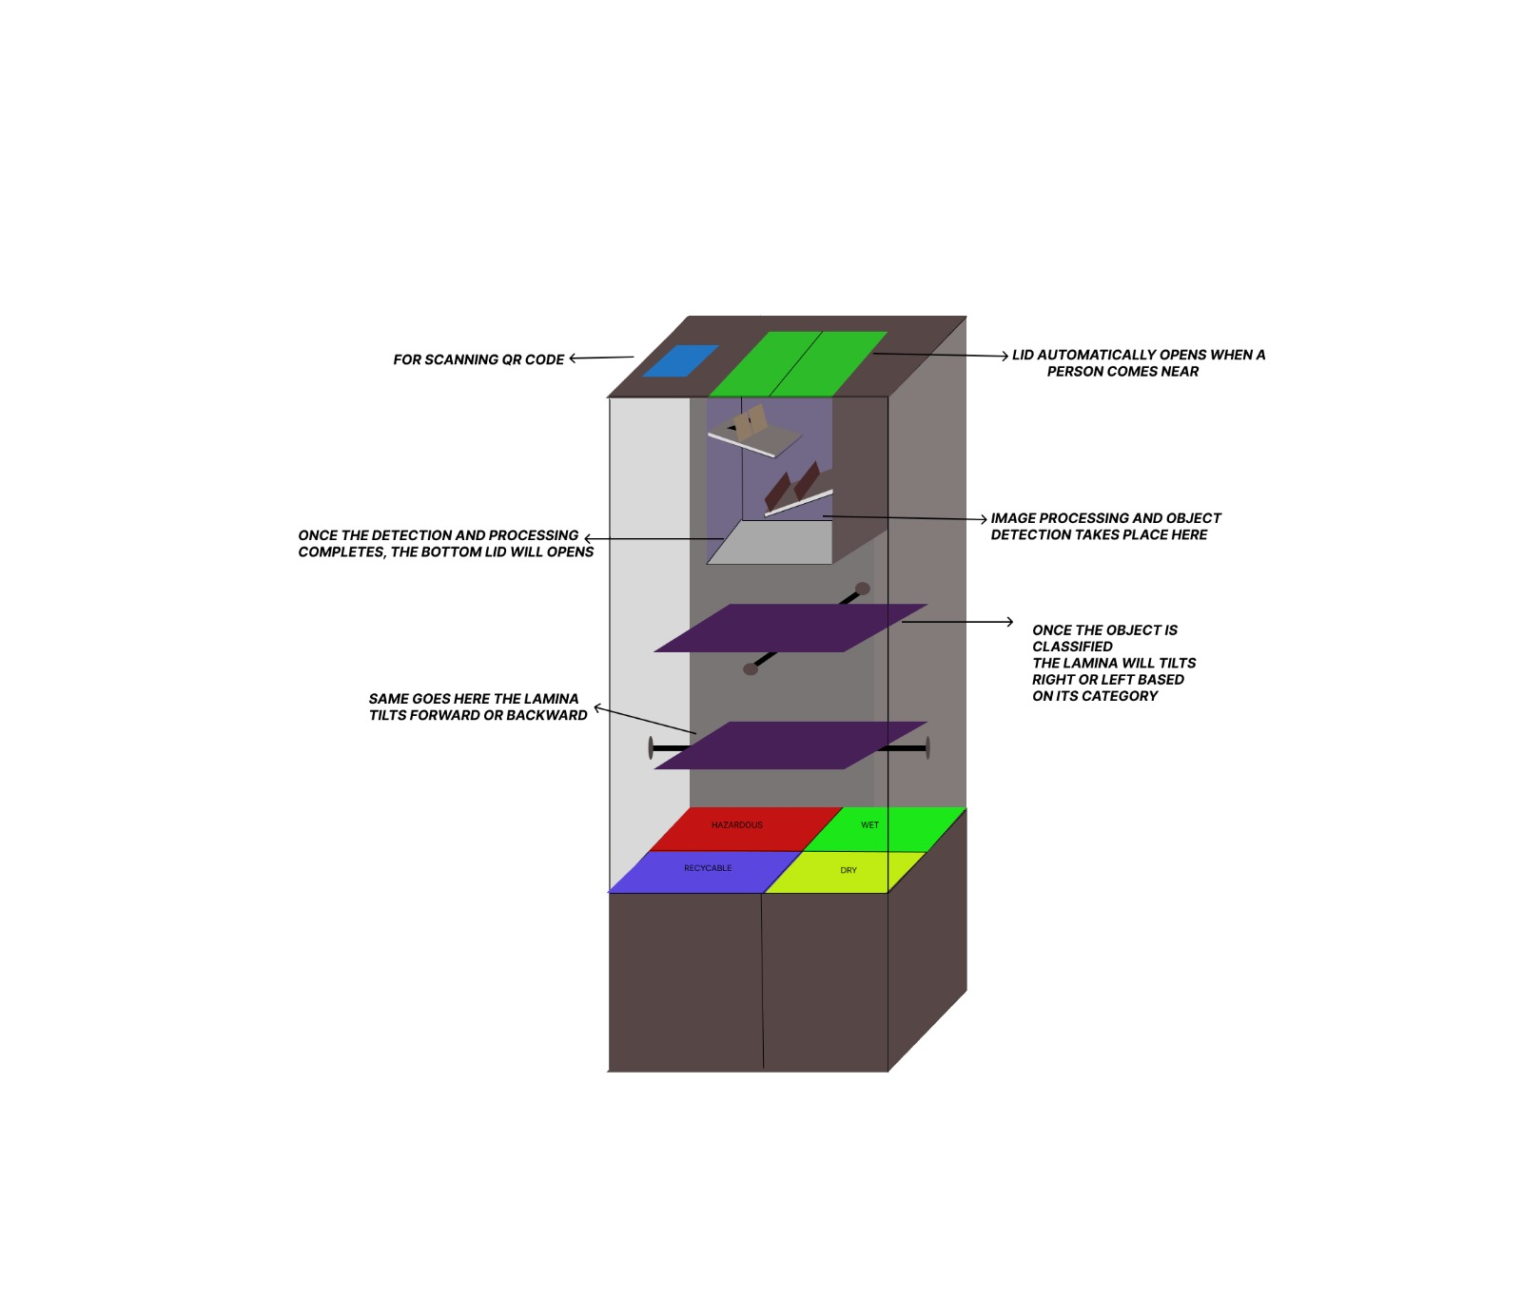
Fig 1: Proposed prototype

Slide 3
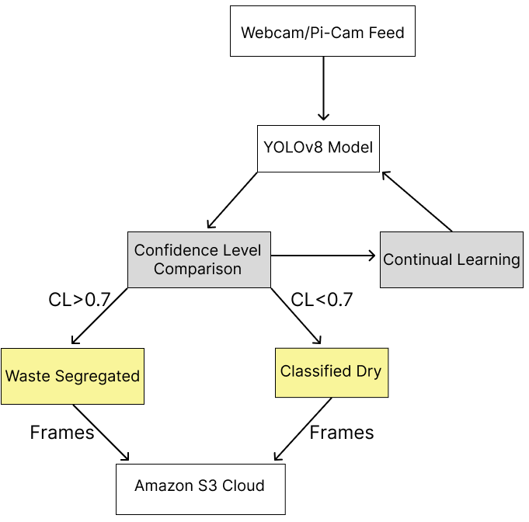
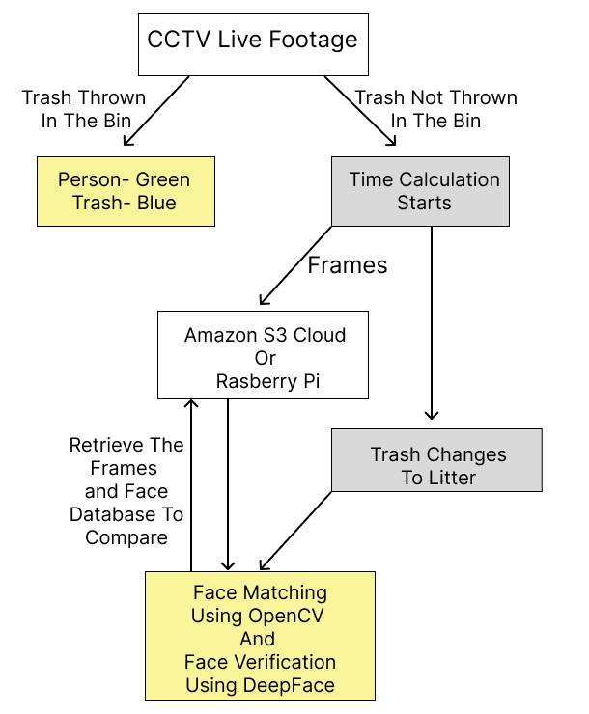
Fig:2 Internal architecture
Fig 3: External architecture

Slide 4
Method of Approach:
Use Cases:
Tech Stack:
Dependencies / Show stoppers:
Parks
Apartment societies
Commercial and corporate companies
Educational institutions such as schools and colleges
Transport hubs such as airports, bus stations, train stations
Hospitals
SOFTWARE:
YOLOv8, OpenCV2 – image classification, CVAT.ai – for data annotation.
HARDWARE:
Raspberry pi OS, Cameras, Servo motors, Sensors, Arduino UNO, Arduino Nano
Real-time Processing
Failures of components
Integration Issues

Slide 5
TEAM 200 OK
NAME | COURSE | BRANCH | YEAR
H G VASUDEVA | B.E | AI&ML | 2ND
UDAY KUMAR G | B.E | AI&ML | 2ND
SHARATH S | B.E | AI&ML | 2ND
VISHAL NANDYAL | B.E | AI&ML | 2ND

